Slide 1
Occam's razor AND machine learning: i) the chemometric approach, ii) two statistical cultures, and iii) the lack of validation in machine learning
Hungarian Research Network
Károly Héberger
Plasma Chemistry Research Group, Institute of Materials and Environmental Chemistry,
HUN-REN Research Centre for Natural Sciences, Institute of Excellence, Hungarian Academy of Sciences

Slide 2
William of Ockham—Occam’s razor
"We may assume the superiority ceteris paribus [other things being equal] of the demonstration which derives from fewer postulates or hypotheses."
Aristoteles
"We consider it a good principle to explain the phenomena by the simplest hypothesis possible."
Ptolemaeos
"Entities must not be multiplied beyond necessity."

Slide 3

William of Ockham

Slide 4
William of Ockham—Occam’s razor
"We may assume the superiority ceteris paribus [other things being equal] of the demonstration which derives from fewer postulates or hypotheses."
Aristoteles
"We consider it a good principle to explain the phenomena by the simplest hypothesis possible."
Ptolemaeos
Occam's razor: i.e., distinguishing between two hypotheses either by "shaving away" unnecessary assumptions or cutting apart two similar conclusions.
"Entities must not be multiplied beyond necessity."

Slide 5
Chemometric Approach; Definition
“The chemometrics is a chemical discipline that uses mathematical and statistical methods to design or select optimal procedures and experiments, and to provide maximum chemical information by analyzing chemical data. ”
1970-80 (!)

Slide 6
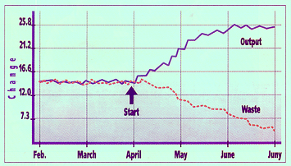
Introduction of chemometrics

Slide 7
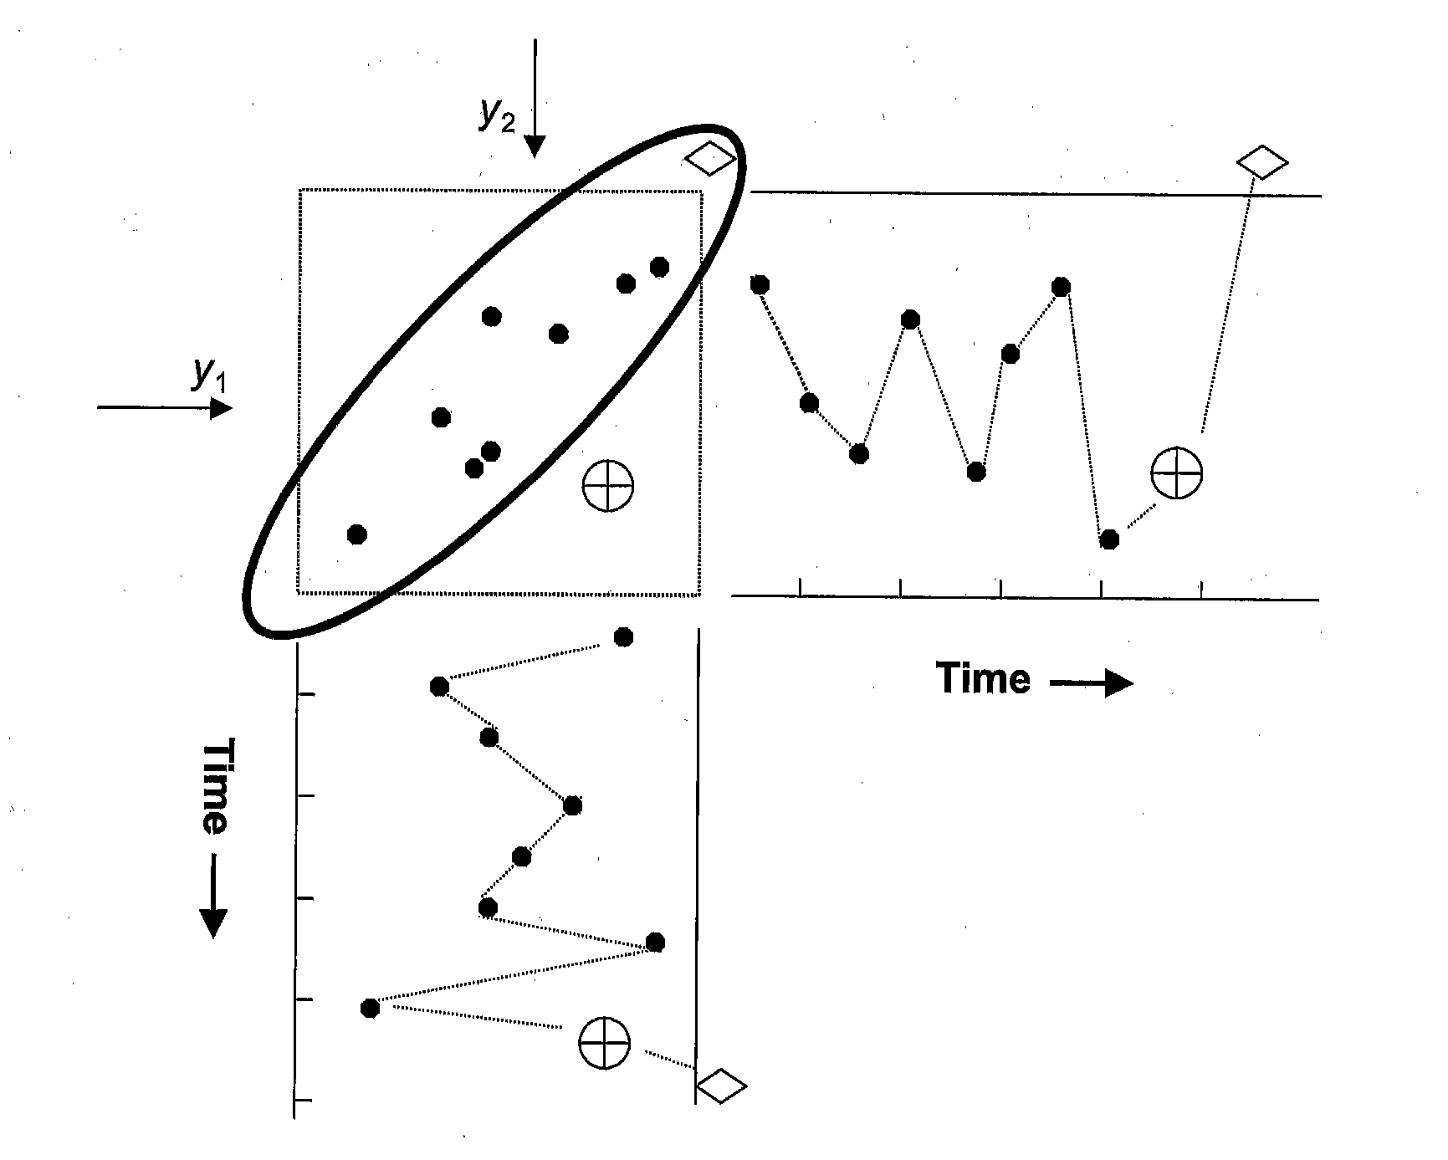
Advantages of Multivariate Approach

Slide 8
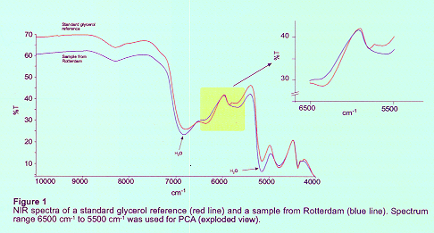
Haiti Affair

Slide 9
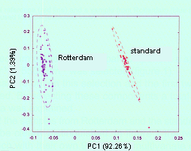
Principal Component Analysis

Slide 10

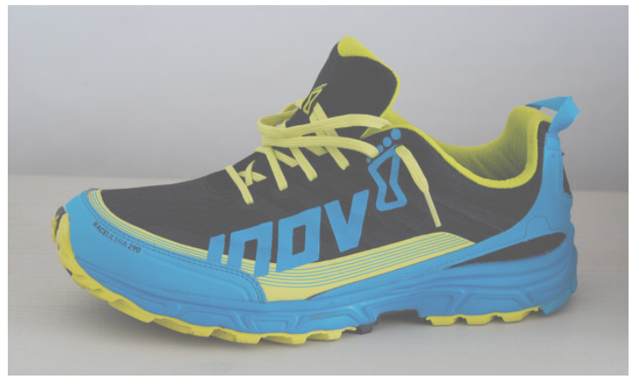
Hard and Soft Modeling

Slide 11
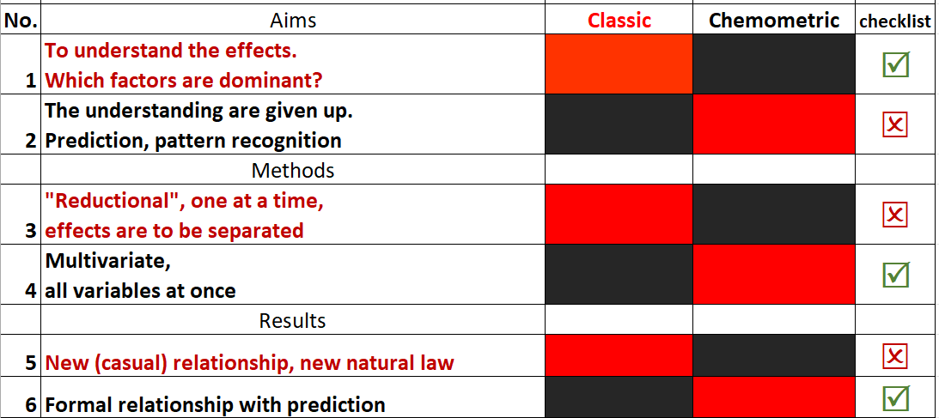
Comparison

Slide 12
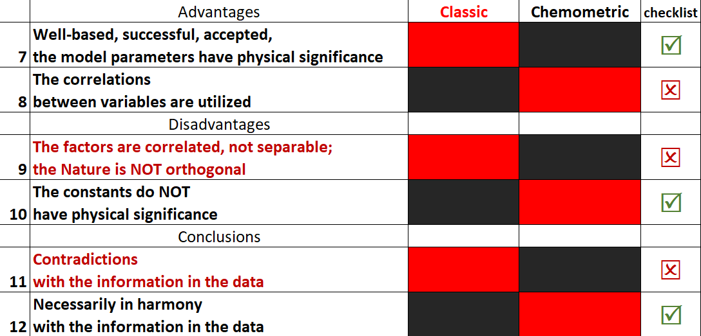
Comparison (cont.)

Slide 13
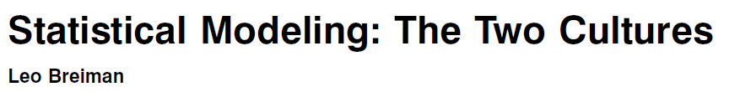
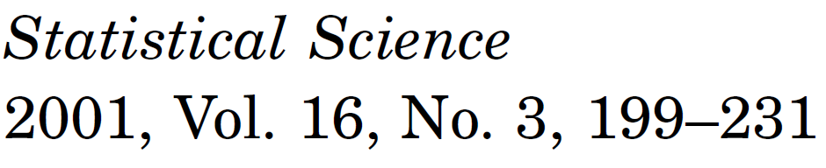
Two Cultures
Chemometrics: 1970-80 (!)

Slide 14
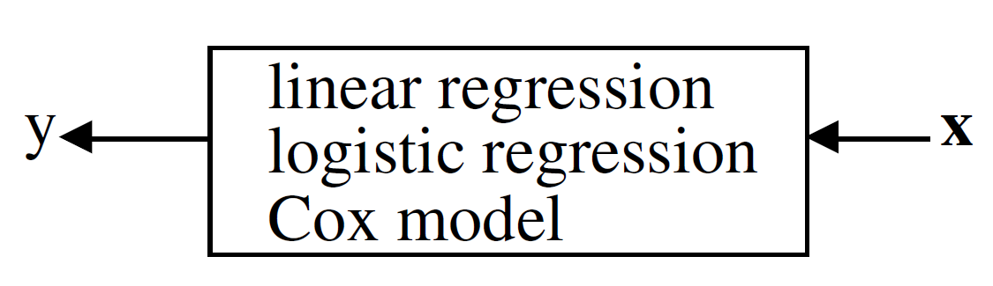
Data model (stochastic model)
Prediction - the responses to future input variables;
Information - how Nature associates the response variables
Validation - Yes–no (goodness-of-fit tests and residual examination.) 98% of statisticians.

Slide 15
Nate Silver, data scientist
Statistics aren’t just numbers. Statistics requires an understanding to use the numbers correctly.
Correlation is not causation. Overfitting is a sin!
The average is still the most useful statistical tool ever invented.
Making predictions improves accountability. (Predictions are the very core of theory and scientists stake claims that could affect their reputation).
Human intuition can often cause errors when it comes to making statistical judgments and inferences.
The word ‘complex’ means the problem is not understood.

Slide 16
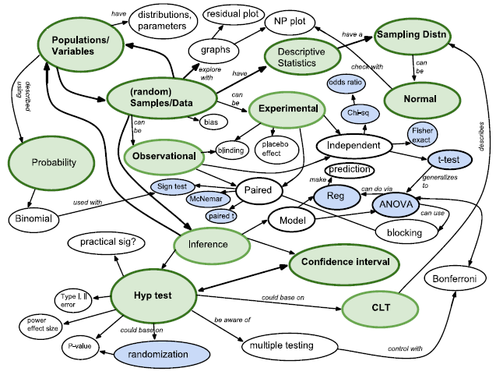
J. A. Witmer, Concept map
Notes:
Jeffrey A. Witmer, Concept maps in introductory statistics, Teaching Statistics © 2015 Teaching Statistics Trust, 38, 1, pp 4–7.

Slide 17
Results of data modeling
Led to irrelevant theory and questionable scientific conclusions;
Kept statisticians from using more suitable algorithmic models;
Prevented statisticians from working on exciting new problems.

Slide 18
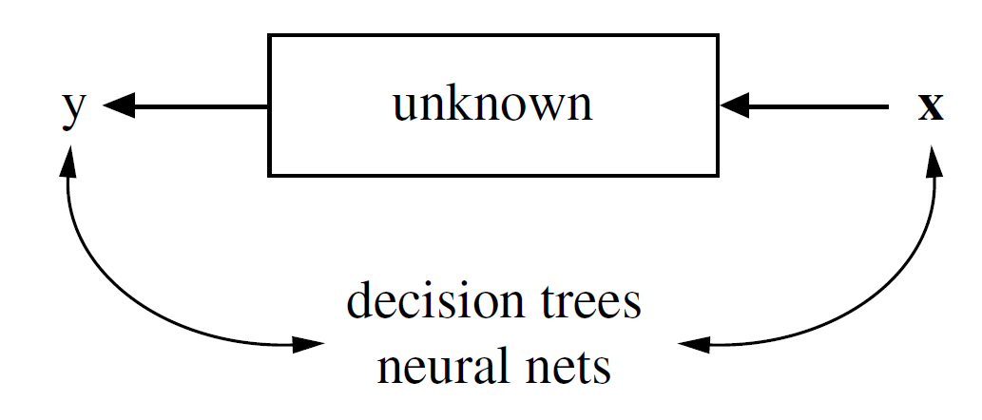
Algorithmic model
Prediction - the responses to future input variables;
Information - ???
Validation - predictive accuracy; ??? 2% of statisticians.

Slide 19
Two Cultures
A black box inside is complex, mysterious, and, partly unknowable.
“My kingdom for some good theory.”
There is an effective method for forming ensembles known as “boosting” ,but there isn’t any finite sample size theory that tells us why it works so well.
The Rashomon Effect = multitude of different descriptions giving about the same minimum error rate.

Slide 20
Two Cultures
Rival algorithms, different selection criteria (R^2, Q^2 RMSE, Cp, MAE, BIC, AIC…)
Result
Several (?) alternative models,
→ ~same description
Methods, which are able to rank, (order) the variables according to some criterion are a useful aim to be pointed out.

Slide 21
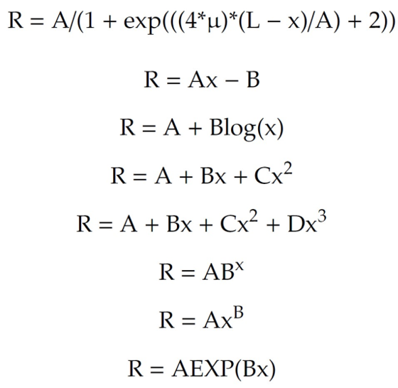
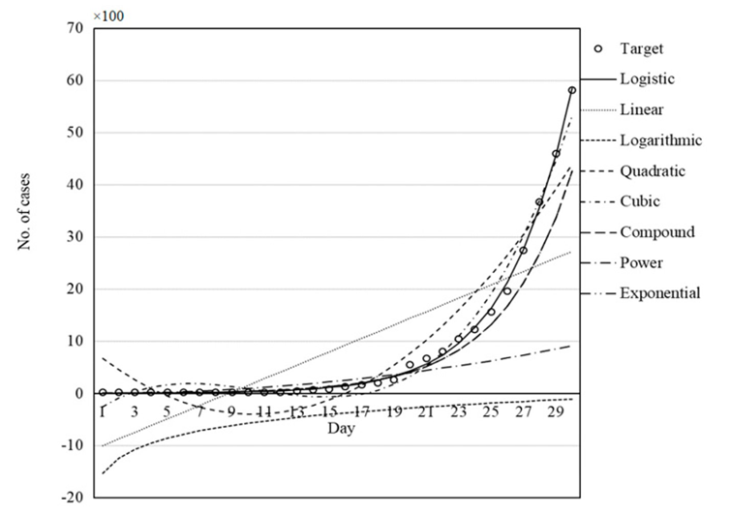
Occam’s razor? Covid pandemic
Héberger, K. Frequent Errors in Modeling by Machine Learning: A Prototype Case of Predicting the Timely Evolution of COVID-19 Pandemic. Algorithms 2024, 17, 43. https://doi.org/10.3390/a17010043

Slide 22
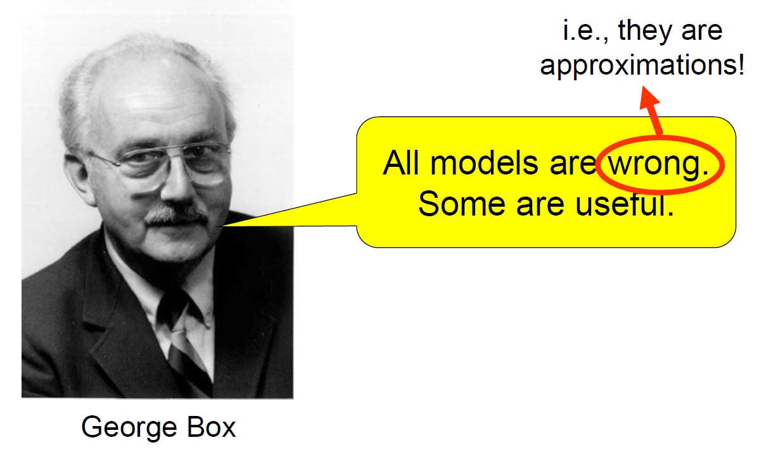


Slide 23
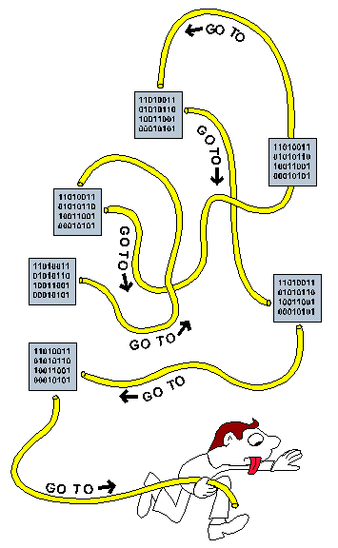
Spaghetti coding
https://www.pcmag.com/encyclopedia/term/spaghetti-code

Slide 24
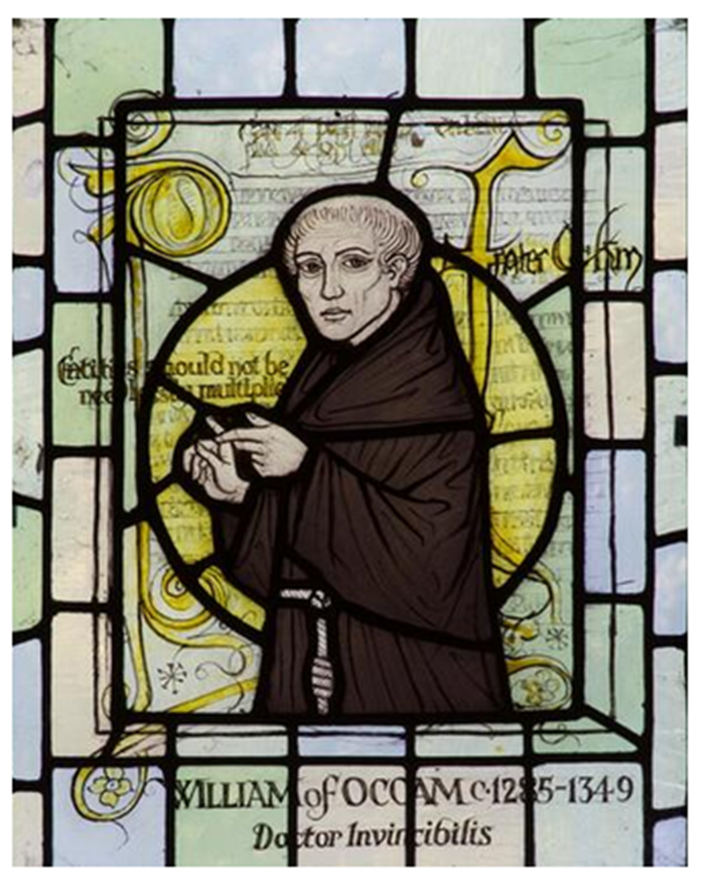
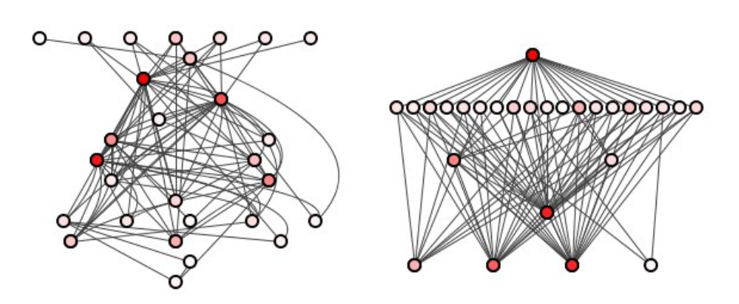
Spaghetti coding
Unstructured coding

Slide 25
Two Cultures
Data model (mechanism unknown).
Algorithmic modeling uses data.
Prediction - the responses to future input variables;
Information - how Nature associates the response variables
The belief in the infallibility of data models is almost religious.—Once a model is made, then it becomes truth and the conclusions from it are unquestionable.

Slide 26
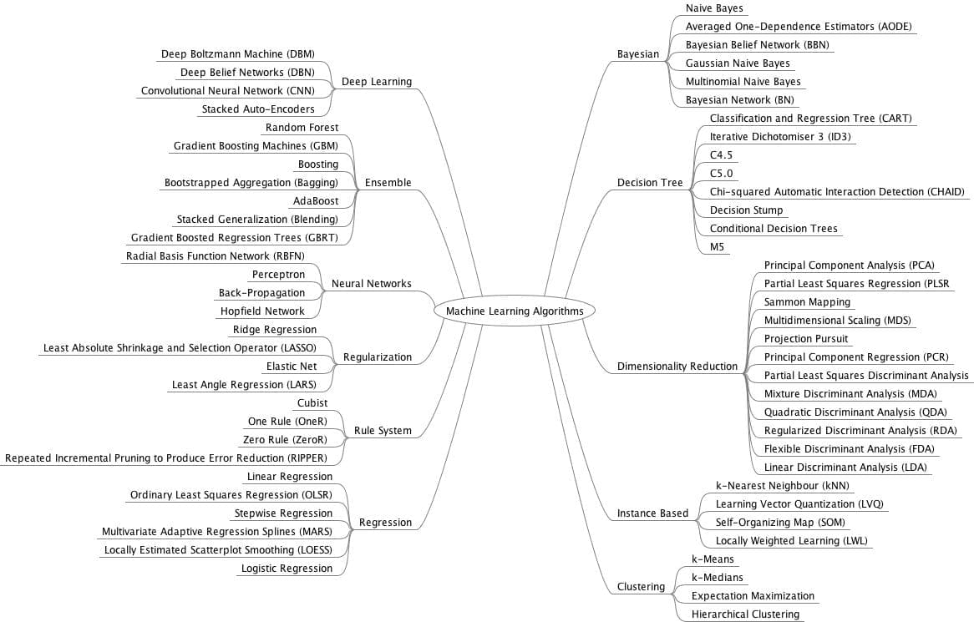
Machine learning algorithms

Slide 27
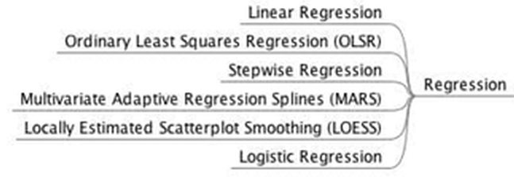
Jason Brownlee

Slide 28
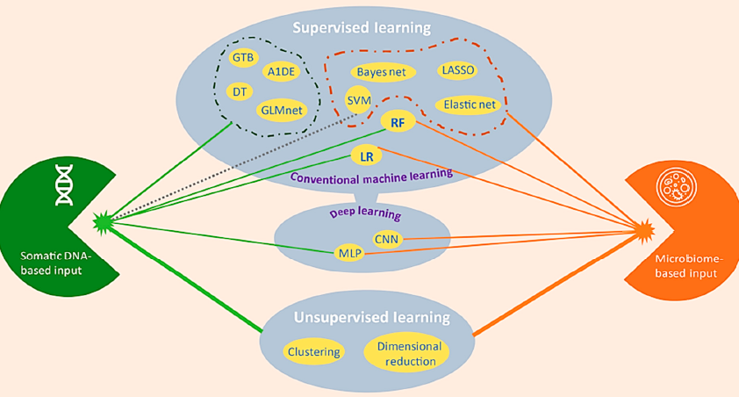
ML classifiers in colon cancer

Slide 29
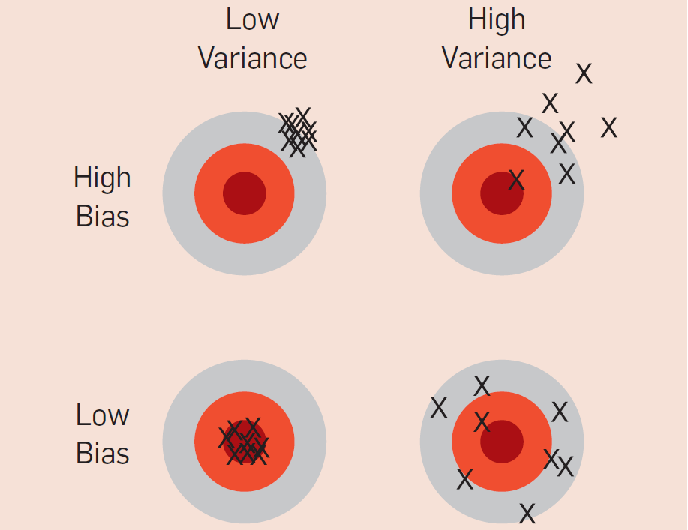
Bias-variance illustration (dart-throwing)

Slide 30
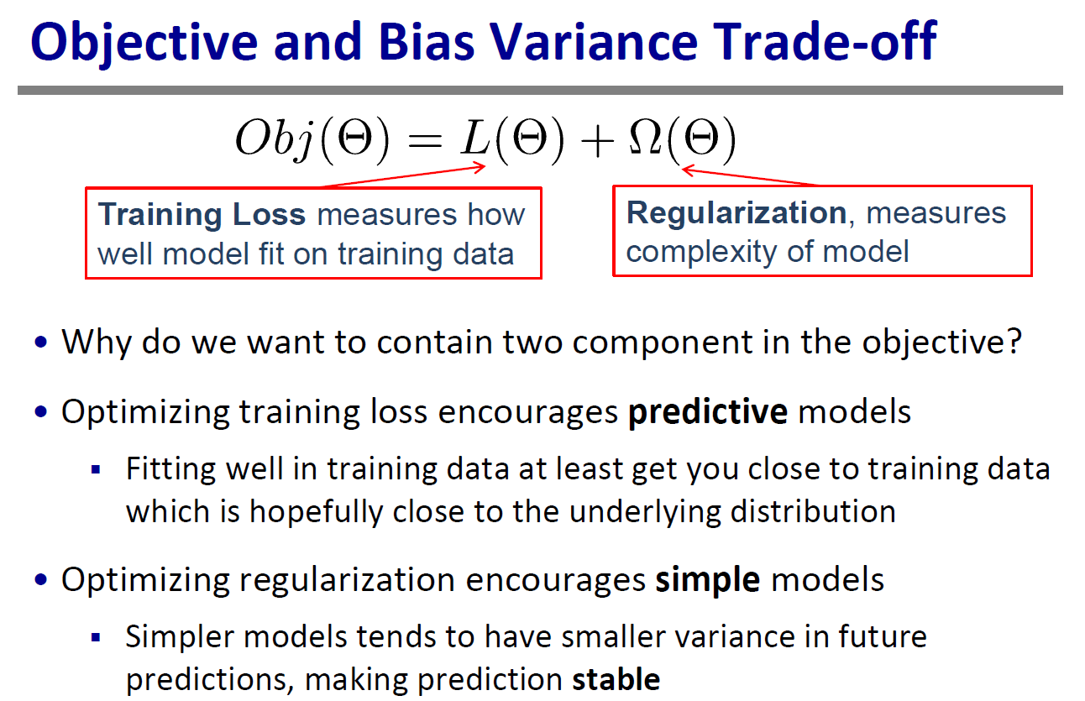
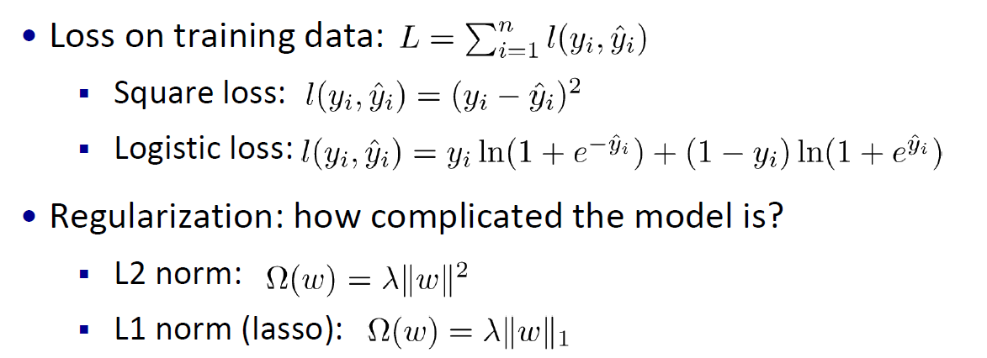
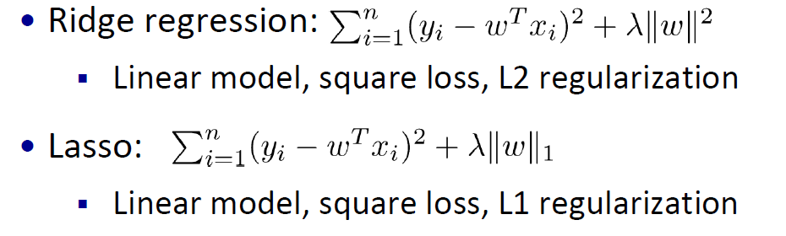
Machine learning

Slide 31
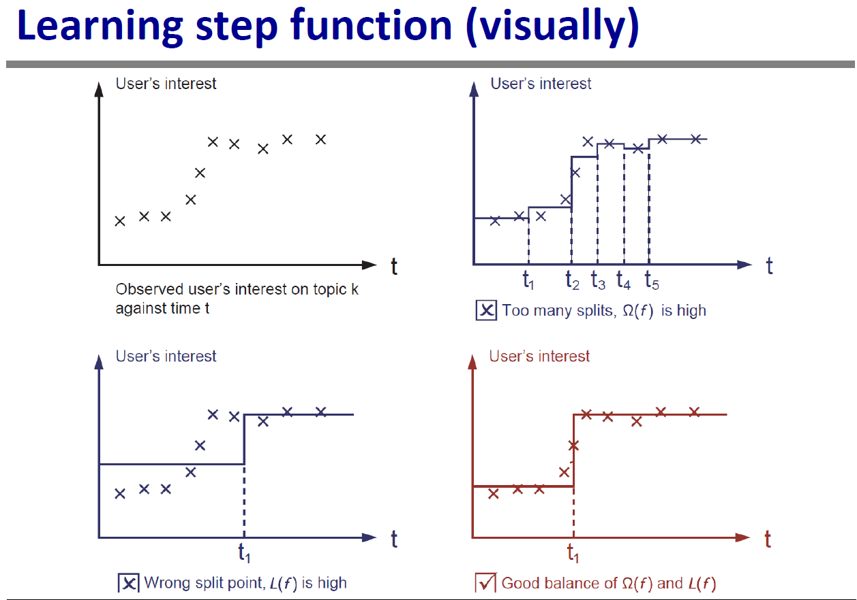
Machine learning

Slide 32
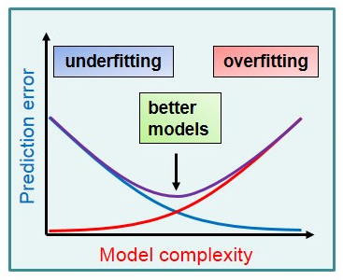
Bias-variance trade-off

Slide 33
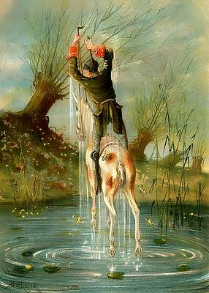
Baron Munchausen pulled himself out of swamp. He grabs the straps of his boots and pulls himself loose
Bootstrapping: a common term for something seemingly impossible or counterintuitive;
statistical bootstrapping - resampling from your data to approximate resampling from a population;

Slide 34
Bias-variance trade-off (real)

Slide 35
Classic machine learning techniques
1) Naïve Bayes
2) k-nearest neighbor (kNN)
3) Artificial neural networks (ANN)
4) Support vector machine (SVM)
5) Decision tree based (DT, CART, GBT, RF, etc.
As a rule of thumb, a dumb algorithm with lots and lots of data beats a clever one with modest amounts of it. (After all, machine learning is all about letting data do the heavy lifting.)

Slide 36
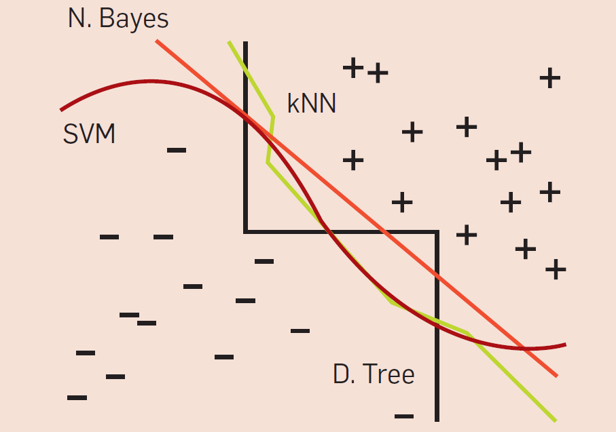
Comparison of machine learning classifiers

Slide 37
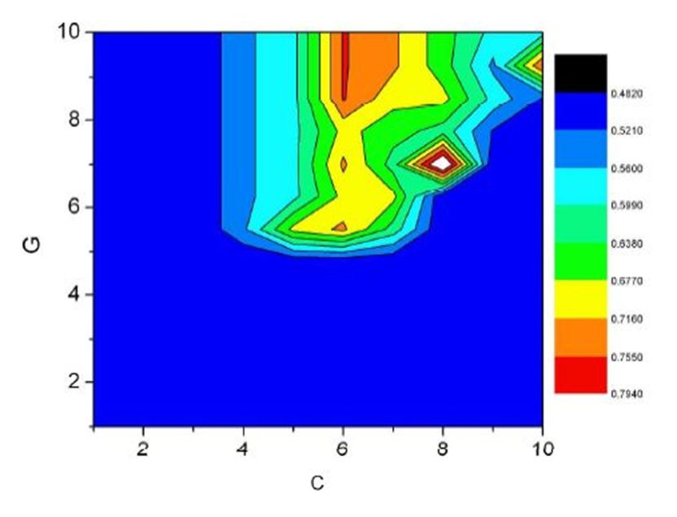
Landscape of meta parameters

Slide 38
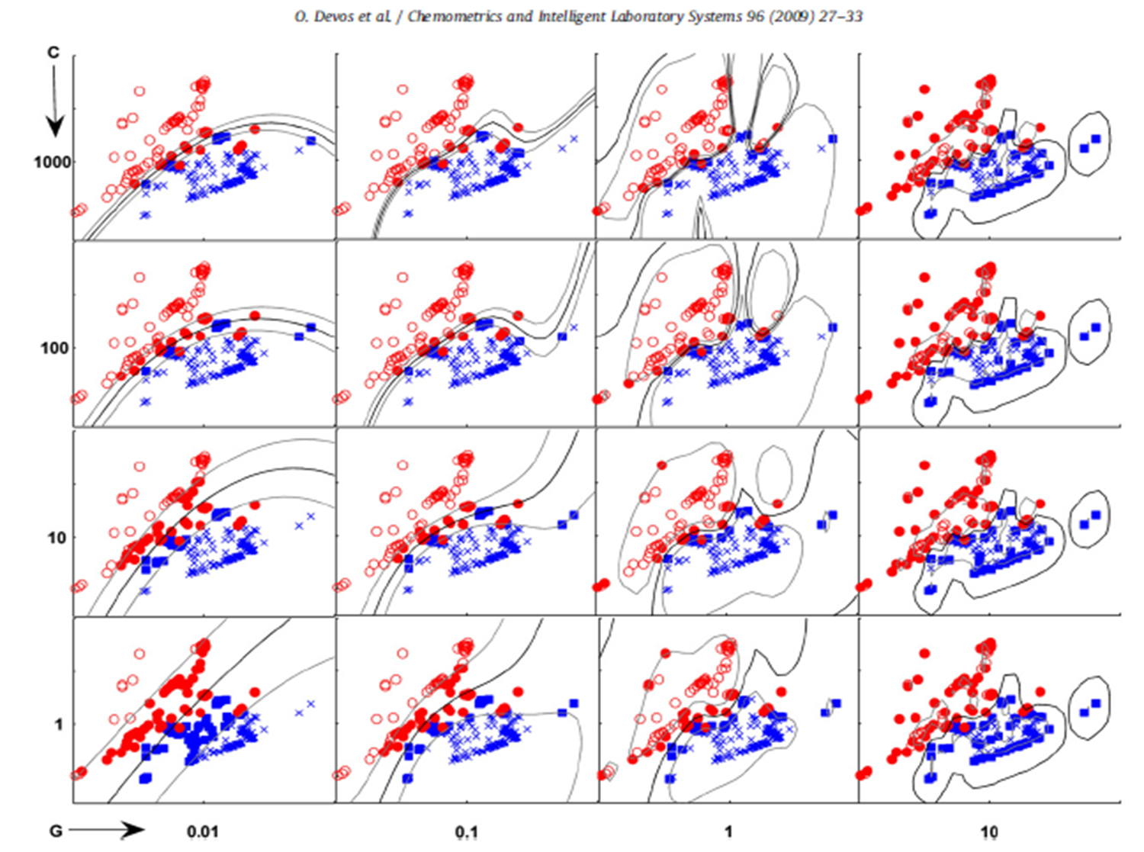
Landscape of meta parameters

Slide 39
A dumb algorithm with lots of data beats a clever one:

Slide 40
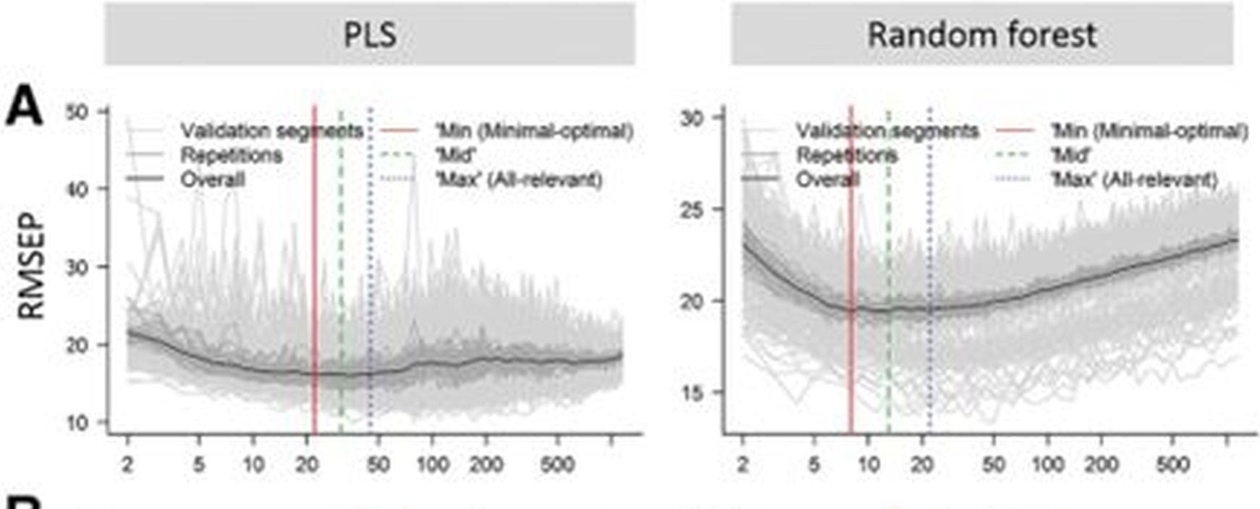
Comparison of PLS and Random Forest

Slide 41
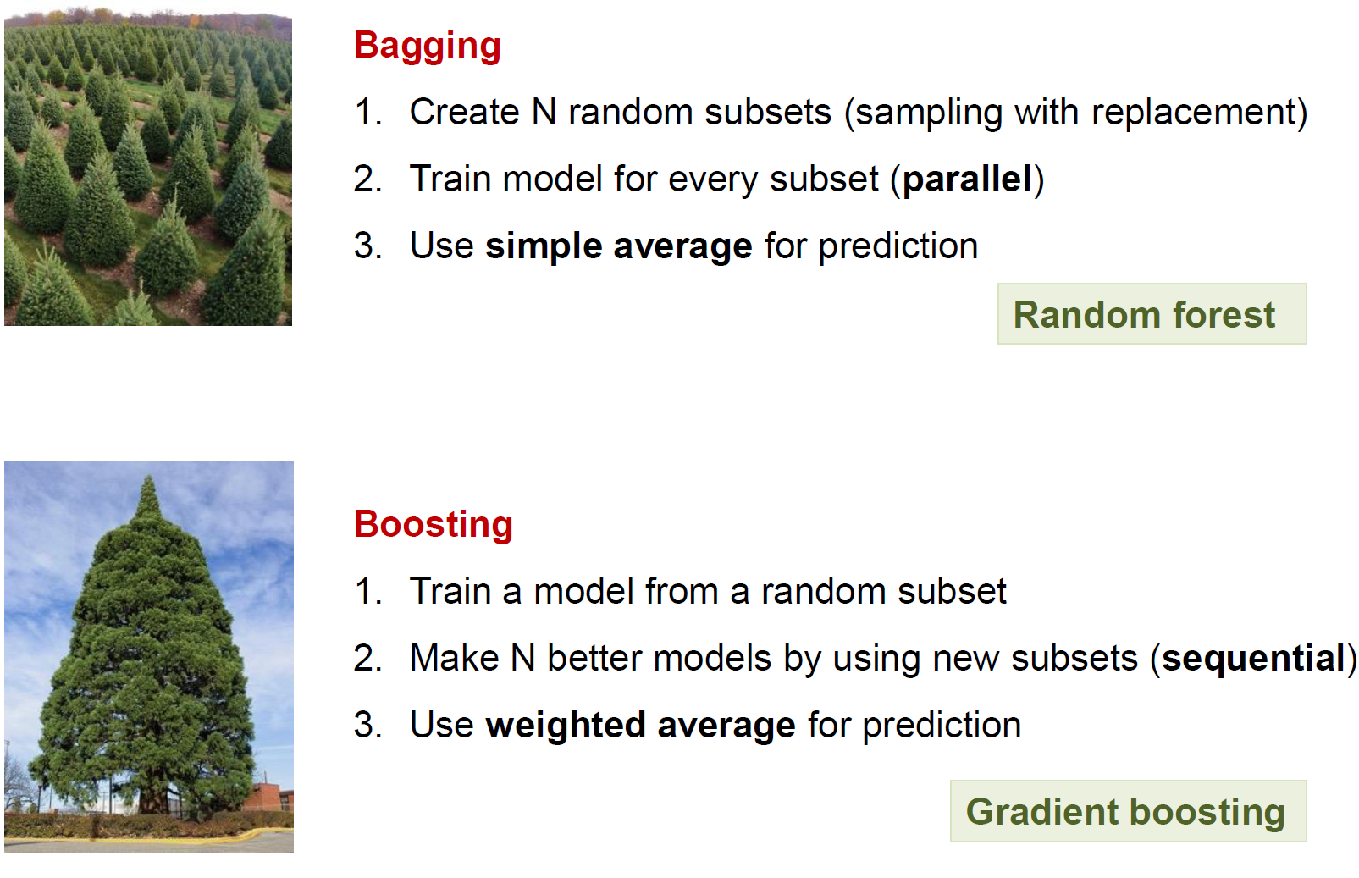
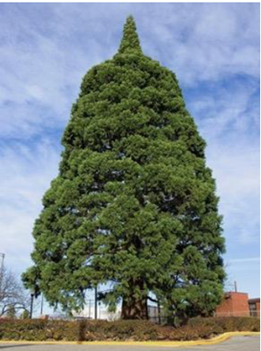

Decision trees ensembles

Slide 42
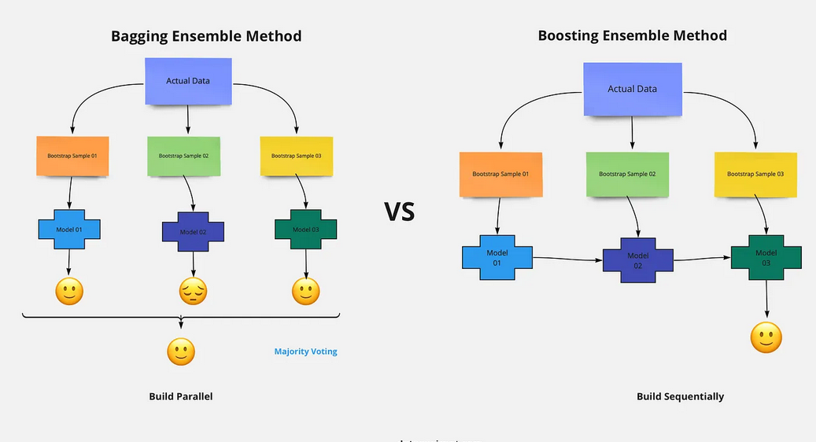
Bagging or boosting?

Slide 43
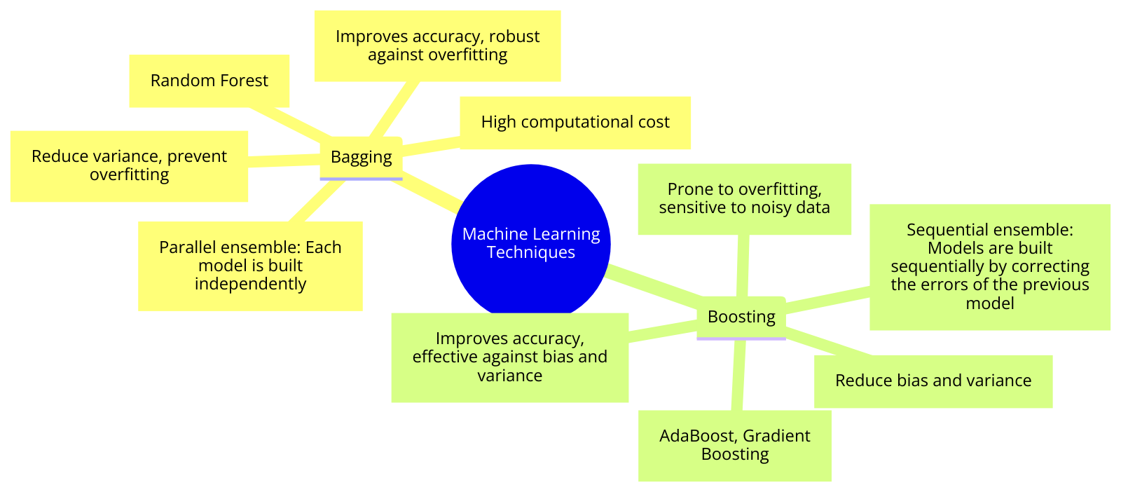




Bagging or boosting? —AI

Slide 44

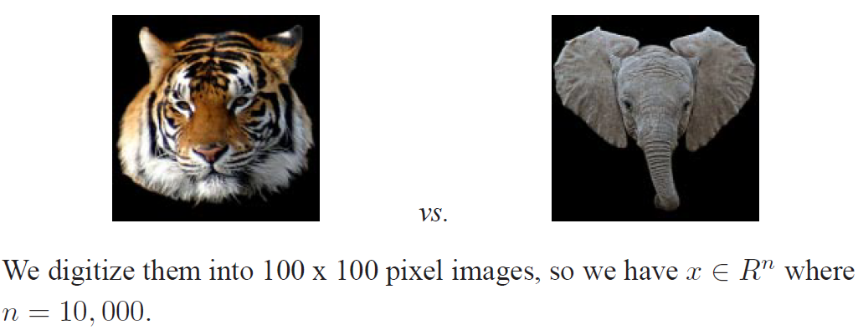
Classification task: elephant or tiger?
Jason Weston, Princeton USA

Slide 45
From statistics to data science
Classic statistic (univariate, H0: yes or no)
Multivariate, chemometrics, landscape
MLR, PLSR, PCR, ridge (1), lasso (1), elastic net (2)
Machine learning: more regularization parameters: SVM, RF, GBT, ANN, etc. (Dimension enhancing)
Deep learning, Convolutional NN, big data, AI, Generative AI, AGI, narrow AI…

Slide 46
Lack of validation
Validation is impossible; terrorist-, and accident prediction, etc.
Face-, speech recognition, image analysis, car plates, cancer tissue
Description —prediction ; (interpolation—extrapolation)
Rigorous validation (randomization test, leave-many-out, k-folds (5-10), leave-one-out, bootstrap with return, 70-30%

Slide 47
Acknowledgement
Many thanks for your kind attention!
Anita Rácz, for drawing some figures.
Daru János (ELTE), Paragi Gábor (PTE, SZTE),
Tóth Gergely (ELTE)
This work was supported by the Ministry of Innovation and Technology of Hungary from the National Research, Development and Innovation Fund, financed under the K type funding scheme. (OTKA K 134260).

Slide 48
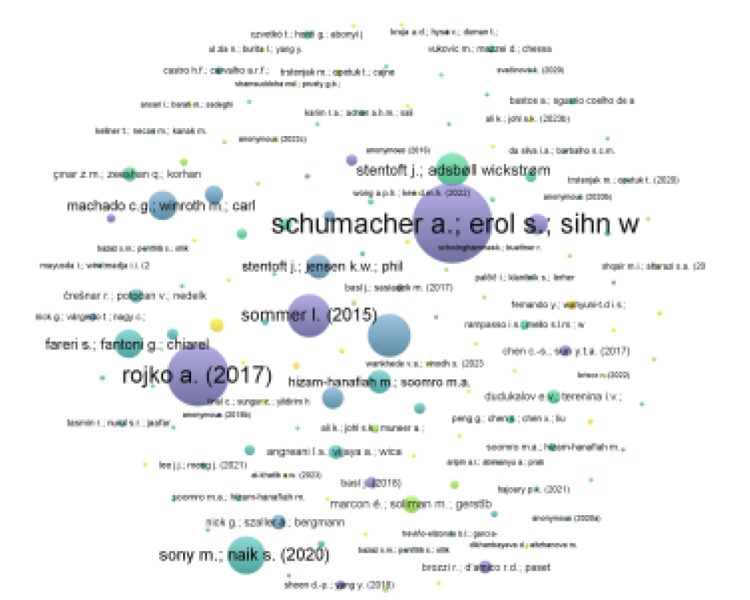
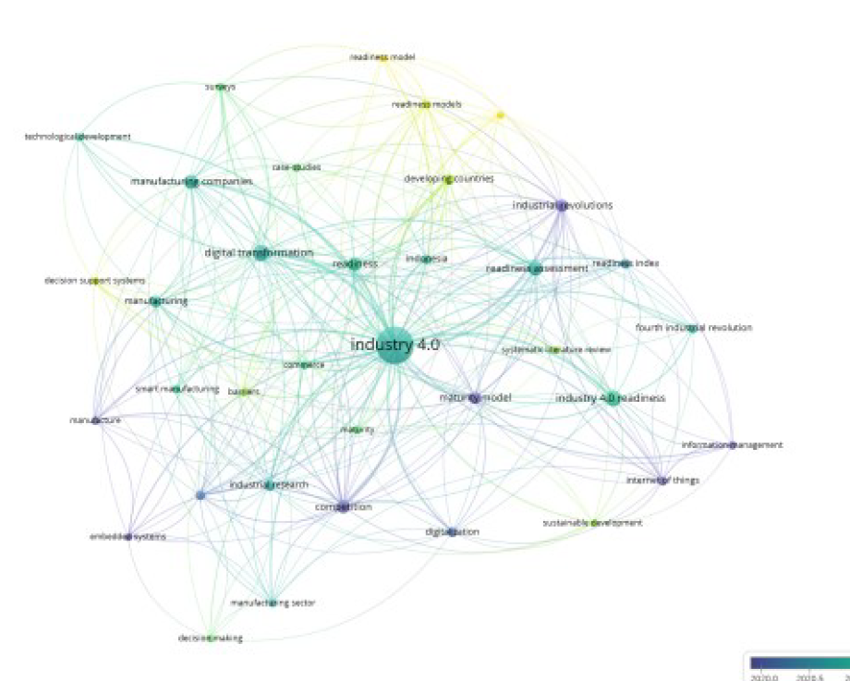
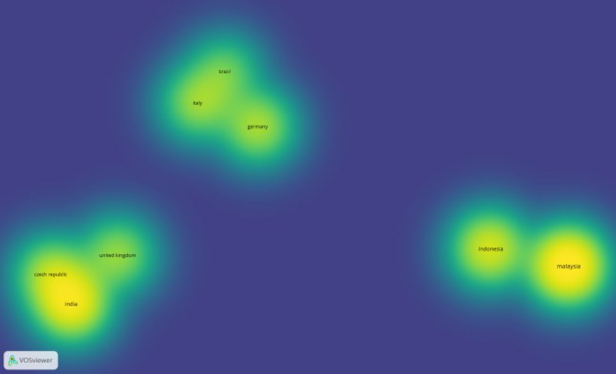
Industry 4.0: Internet of Things (IoT), artificial intelligence (AI), robotics, and big data in production
Keywords: readiness, digital transformation, readiness assessment, and manufacturing companies

